Slide 1



Home Automation using Raspberry Pi and MQTT Cloud
Members: Debanjali Saha (1810110059), Hrishika Enugula (1810110079), Isha Arora (1810110084)

Slide 2
AIM/OBJECTIVE:
To control home appliances from anywhere using MQTT server hosted on cloud and the Raspberry Pi.
We have used the Adafruit IO as MQTT broker to control an appliance connected to Raspberry Pi GPIO in the lab.
Why use MQTT cloud and not local MQTT server?
The drawback of local MQTT server is that we cannot control the GPIOs from anywhere in the world, it only provides services locally. But if this MQTT server is hosted on some cloud then any appliances connected to Raspberry Pi can be controlled globally.

Slide 3
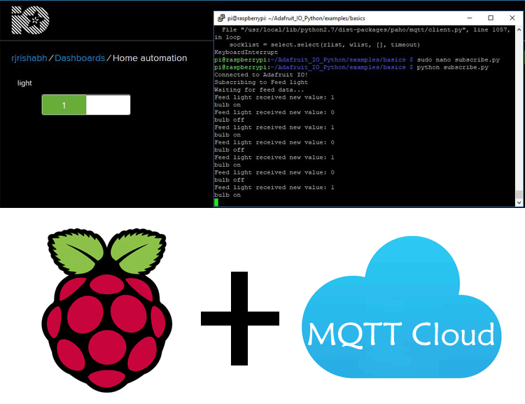
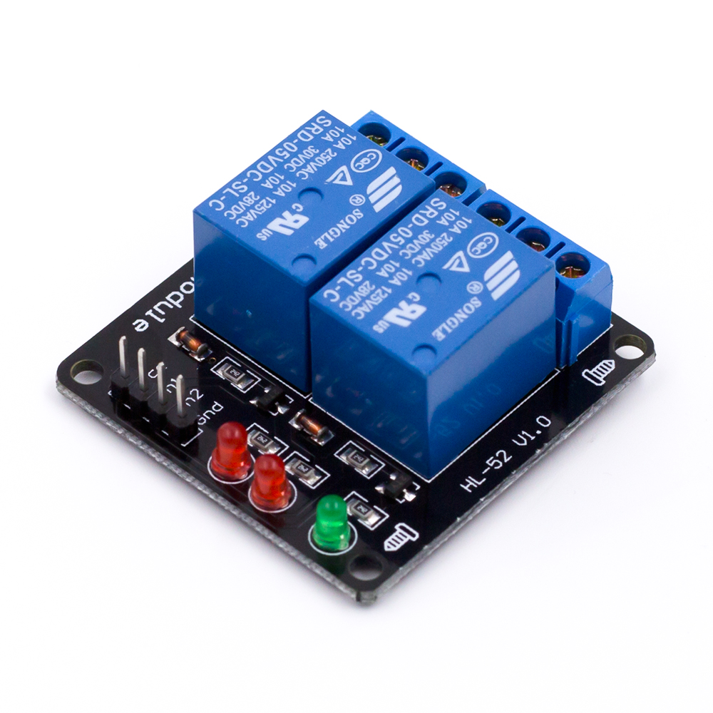
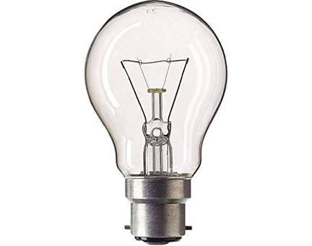
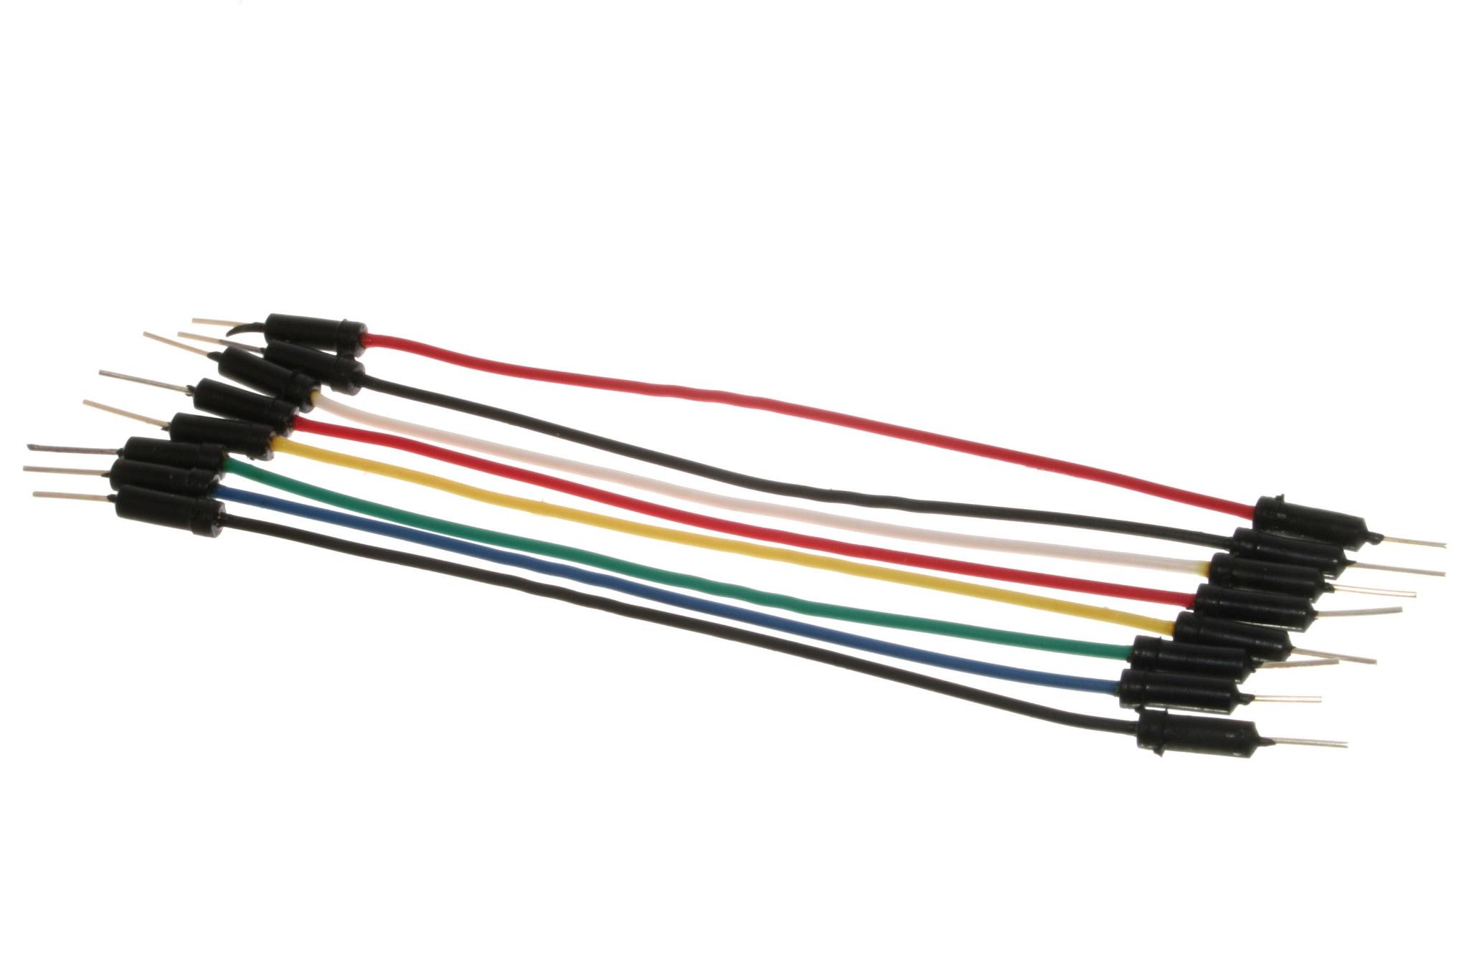
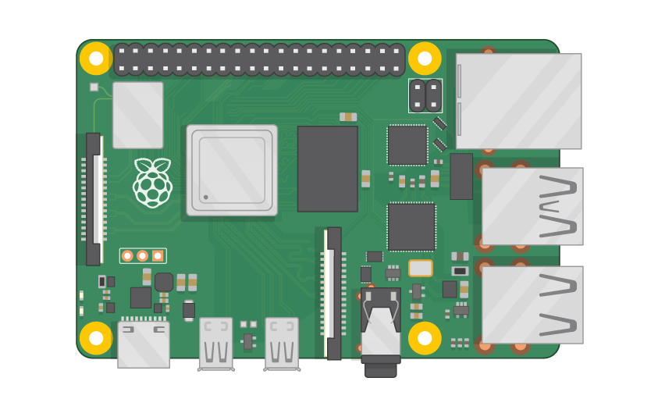
LOGISTICS:
Raspberry Pi with Raspbian Stretch installed in it.
Relay Module
Bulb
Jumper Wires
A laptop/mobile to access the Adafruit IO platform.

Slide 4
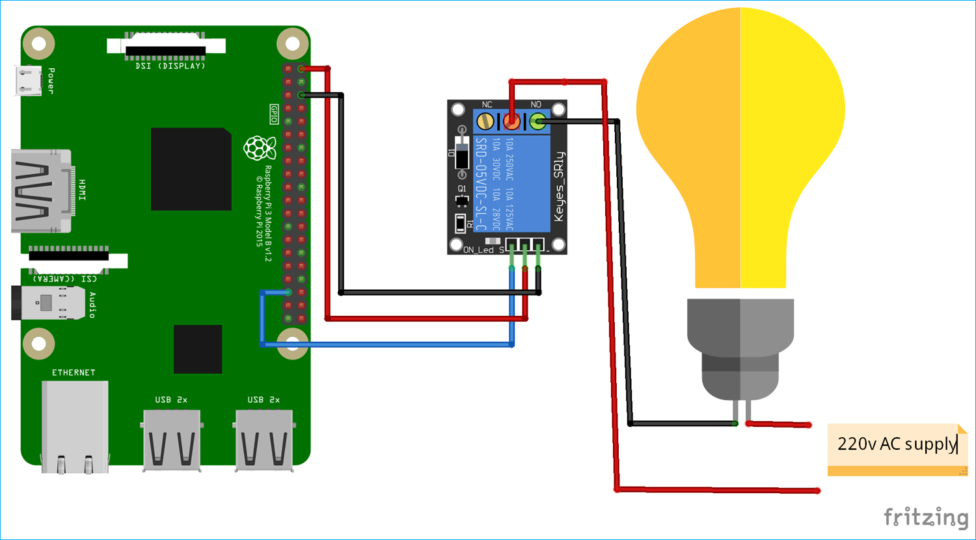
CIRCUIT:

Slide 5
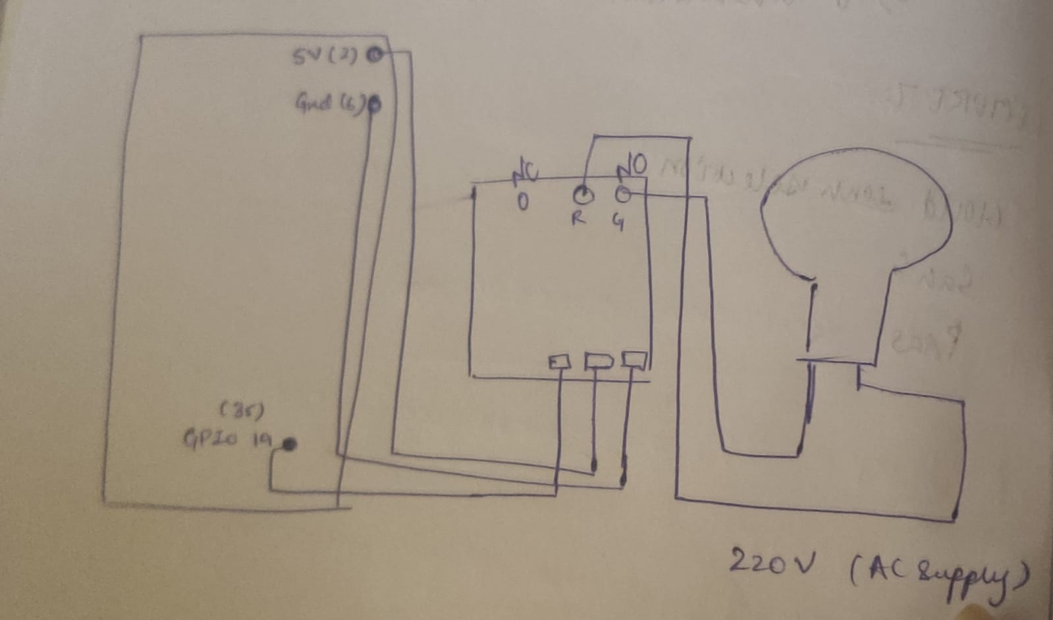
LAB PROCEDURE:

Slide 6
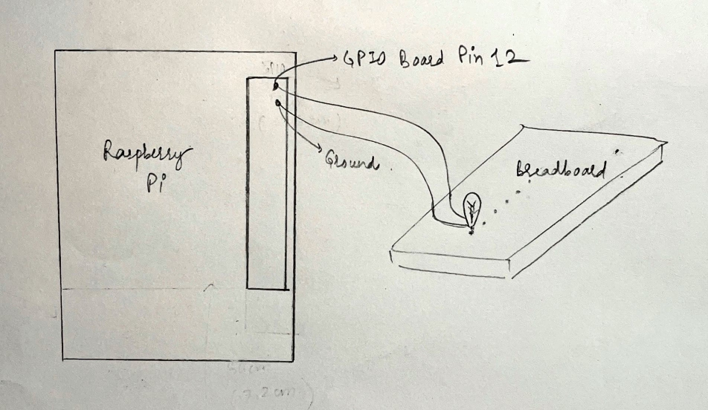
CIRCUIT USED (WITHOUT RELAY MODULE):

Slide 7
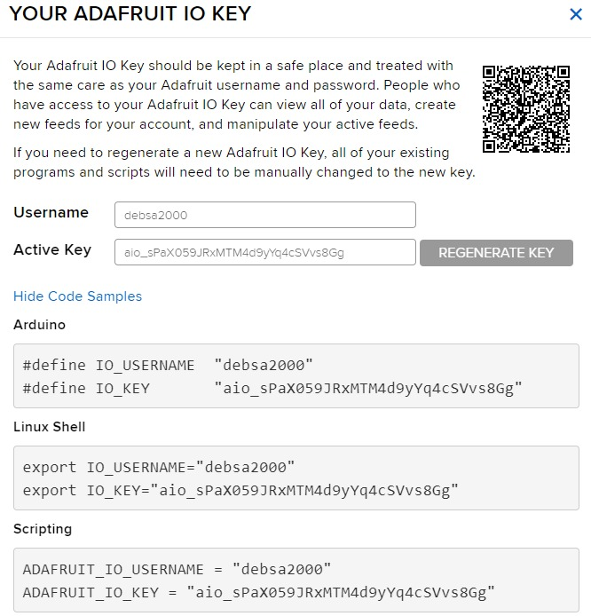
PROCEDURE TO ACCESS ADAFRUIT IO PLATFORM:
Made a free account on Adafruit IO platform and make a feed.
Logged in to Adafruit IO with personal credentials
Created a new dashboard called IoT Project
An Adafruit IO Key is created which will be used in our code.
Next, a new block of type ‘Toggle’ is created to be used as a switch. It is named ‘Bulb Light’. Button on is set up as ‘1’ and off is set up as ‘0’.

Slide 8
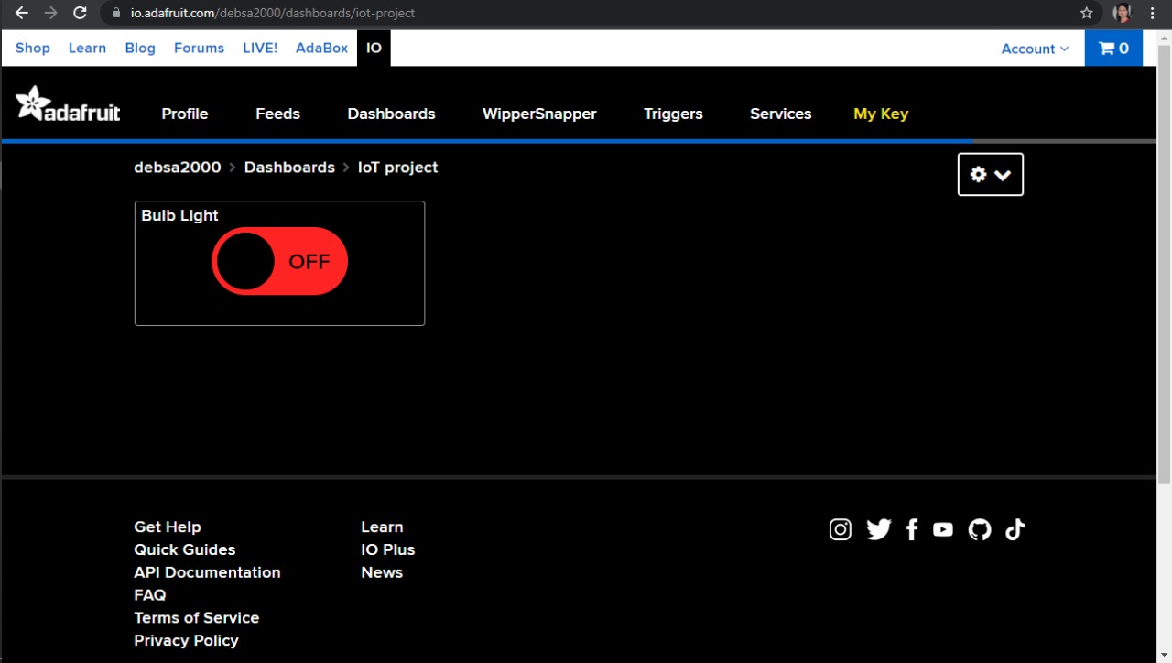

Slide 9
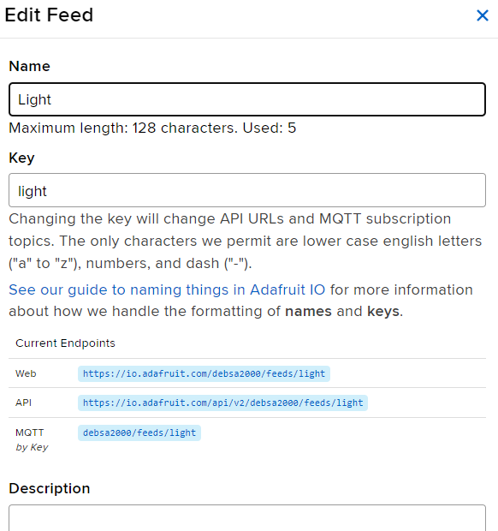
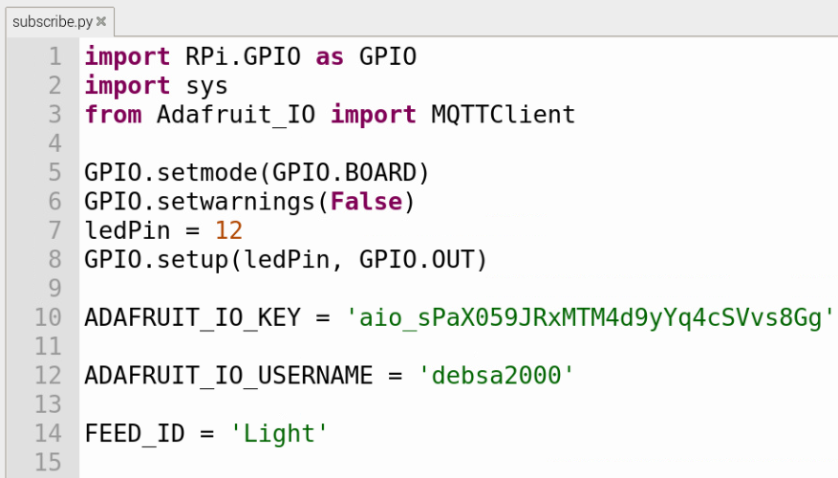
All the required libraries to use GPIO pins and Adafruit MQTT client are imported.
GPIO mode is set and LED pin number and set as output are defined.
Next, we have set AIO key and Username as debsa2000 and user name as aio_sPaX059JRxMTM4d9yYq4cSVvs8Gg.
Enter the feed name to turn on and off the light is entered.

Slide 10
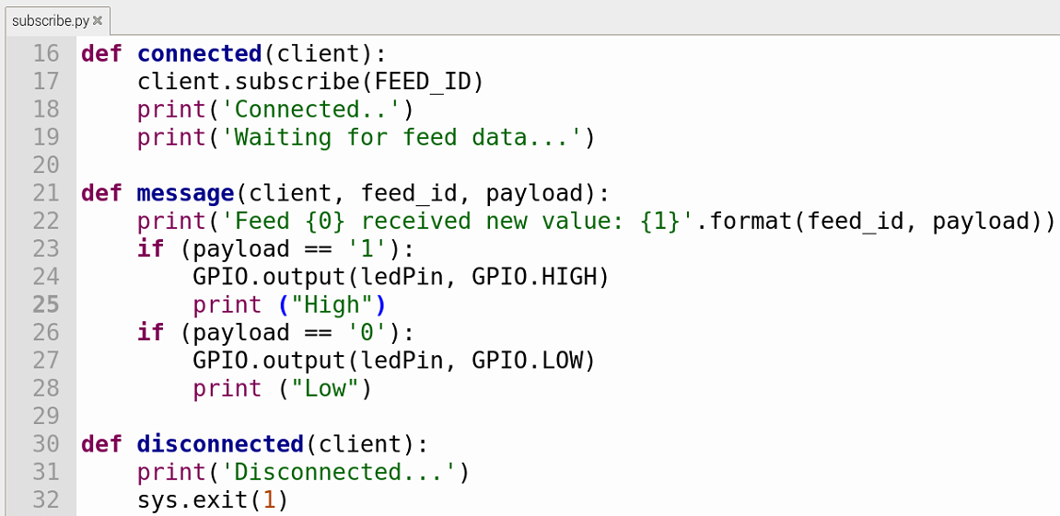
A function that will be called when the event will happen is defined. So, we will subscribe the Feed using client.subscribe(FEED_ID)
After subscribing the feed, we have to check for the new value and store it into a payload variable. For this message function is called. So, whenever there is “1” in payload variable, the led pin is set to HIGH and for “0” it is set to LOW.

Slide 11
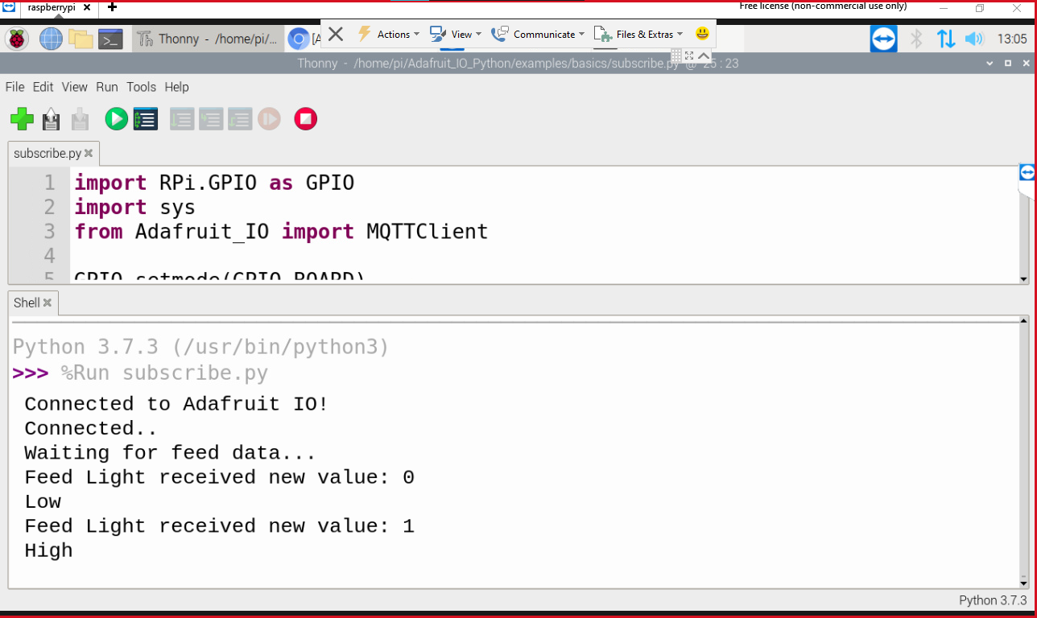

Slide 12
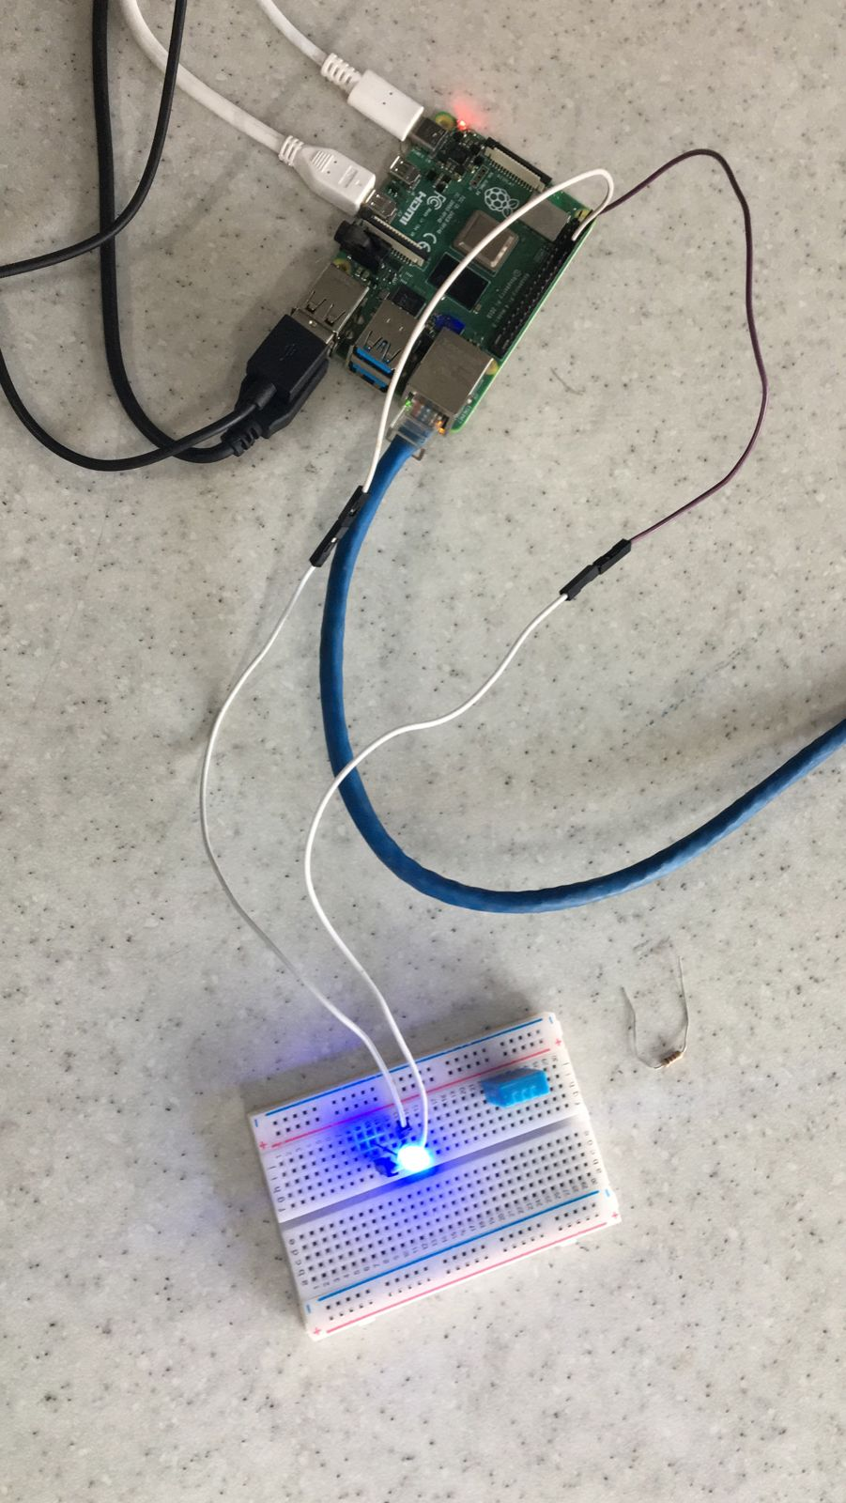
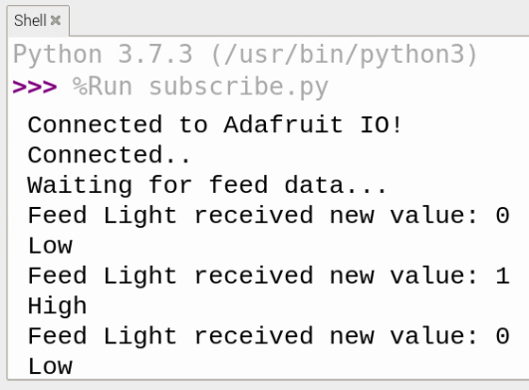

Slide 13
Thank you!

